Slide 1

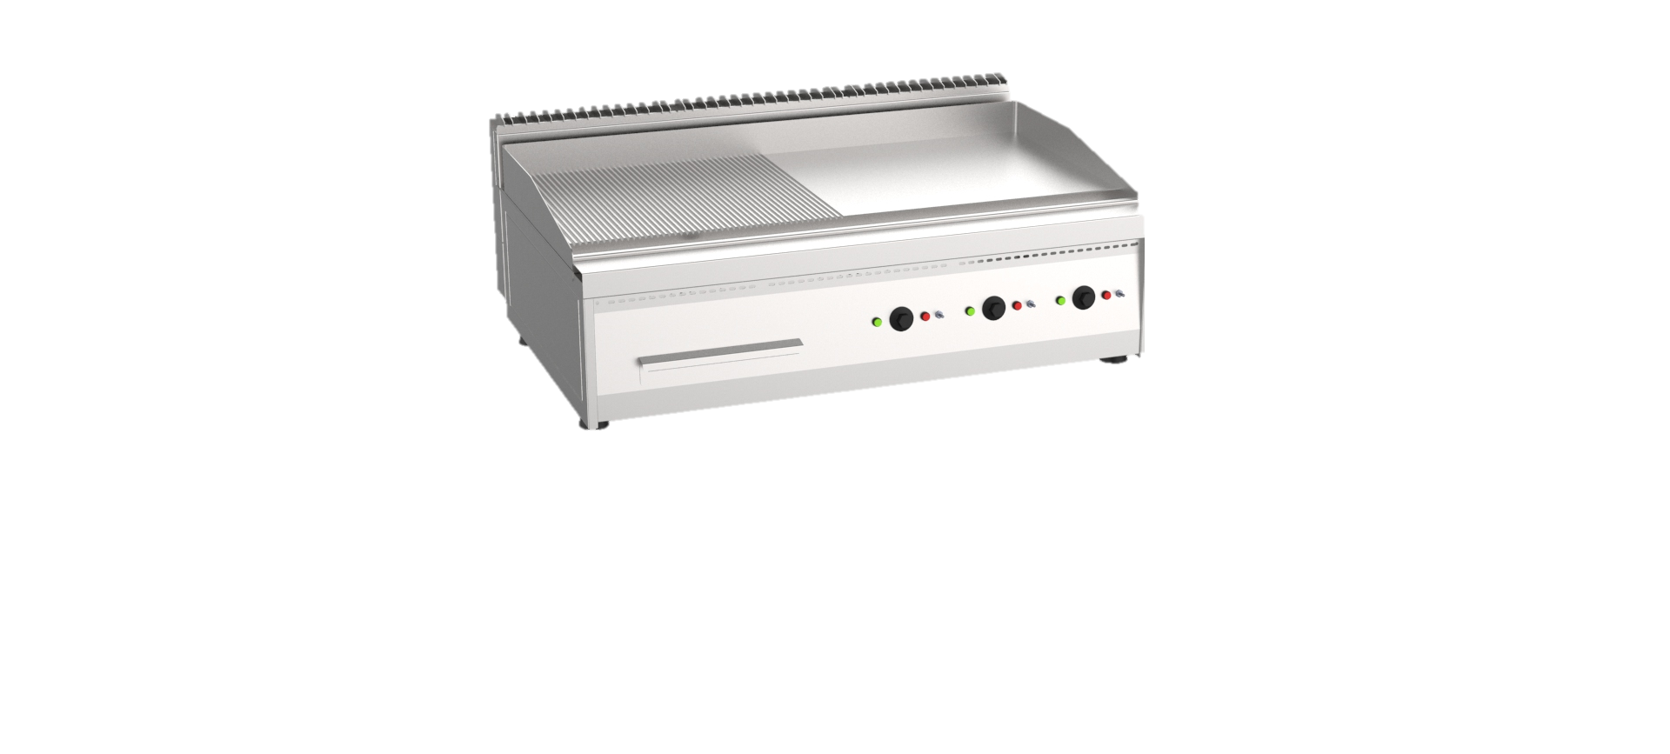





Project:____________ Item # :____________ Quantity :_____________
Electromechanical Electric Chrome Plated Grill Top
Product Description
Your journey to customer loyalty starts here.
Introducing our top-of-the-line electric countertop grill, designed to provide you with the ultimate cooking performance and versatility. Built with durable and corrosion-resistant stainless-steel material, this grill provides a sleek and professional look that is easy to clean and maintain, making it the perfect addition to your kitchen.
Mounted on four circular legs with adjustable feet, this grill is stable and can be raised or lowered to ensure the cooking surface is level and stable. The removable collection pan integrated at the bottom of the grill collects excess oils and crumbs, making cleaning a breeze.
The 25 mm thick steel-top cooking plate features an ultra-smooth surface finish, ensuring even heat distribution and preventing food from sticking to the surface. What sets this grill apart is its versatility - the cooking plate can be smooth, ribbed, or half smooth and half ribbed, providing endless cooking options for any type of food.
With up to three independent cooking zones, this grill provides flexibility in cooking different types of food at different temperatures. Each cooking zone can be controlled independently for precise temperature control and cooking results. The safety thermostat helps regulate the temperature and prevent overheating, which can cause damage or pose a safety risk, ensuring that you can cook with confidence. The electromechanical control system is easy to use and provides precise temperature control for consistent cooking results.
Choose from a range of optional base units, including closed cabinet, open cabinet, refrigerated cabinet, holding cabinet, and oven, to complete your cooking setup.
Transform your cooking experience with our electric countertop grill. With its advanced features and exceptional performance, you can cook your favorite dishes with ease and precision. Whether you are grilling, searing, or sautéing, this grill is versatile enough to handle any task. Invest in the best for your kitchen and elevate your cooking game with our electric countertop grill
Standard Features
Stainless Steel Construction - Made from durable and corrosion-resistant stainless-steel material which provides a sleek and professional look that is easy to clean and maintain.
Thick Steel-top Cooking Plate - 20 mm thick steel top with ultra-smooth surface finish, ensures even heat distribution and prevents food from sticking to the surface.
Versatile Cooking Plate – Cooking plate can be smooth, ribbed, or half smooth and half ribbed.
Executed on 4 S/S circular legs with adjustable feet - Adjustable feet can be raised or lowered to ensure the cooking surface is level and stable and provides a sleek and modern look that complements the stainless-steel construction.
Removable Collection Pan - Integrated bottom mounted pan collects excess oils and crumbs; and pulls out for easy cleaning.
Independent Cooking Zones - Up to 3 independent cooking which provides flexibility in cooking several types of food at different temperatures. Each cooking zone can be controlled independently for precise temperature control and cooking results.
Safety Thermostat - thermostat helps regulate the temperature and prevent overheating, which can cause damage or pose a safety risk.
Electromechanical Control
Optional Features
Closed Cabinet
Open Cabinet
Refrigerated Cabinet
Holding Cabinet
Oven
www.univest.com.eg

Slide 2
Project:____________ Item #:____________ Quantity:_____________
Electromechanical Electric Chrome Plated Grill Top
Model | GE8-04CT-SS | GE8-04CT-GG | GE8-08CT-SS | GE8-08CT-GG | GE8-08CT-SG | GE8-12CT-SS | GE8-12CT-GG | GE8-12CT-SG
Cooking Zones | 1 | 1 | 2 | 2 | 2 | 3 | 3 | 3
Cooking Surface Area | 0.24 m² | 0.24 m² | 0.48 m² | 0.48 m² | 0.48 m² | 0.72 m² | 0.72 m² | 0.72 m²
Cooking Plate Type | Smooth Plate | Ribbed Plate | Smooth Plate | Ribbed Plate | Half-Smooth/ Half-Ribbed | Smooth Plate | Ribbed Plate | Half-Smooth/ Half-Ribbed
Energy source | Electrical | Electrical | Electrical | Electrical | Electrical | Electrical | Electrical | Electrical
Voltage | 380V / 3PH / 50Hz | 380V / 3PH / 50Hz | 380V / 3PH / 50Hz | 380V / 3PH / 50Hz | 380V / 3PH / 50Hz | 380V / 3PH / 50Hz | 380V / 3PH / 50Hz | 380V / 3PH / 50Hz
Electric Power | 6 kW | 6 kW | 12 kW | 12 kW | 12 kW | 16 kW | 16 kW | 16 kW
Type of Control | Electro-mechanical | Electro-mechanical | Electro-mechanical | Electro-mechanical | Electro-mechanical | Electro-mechanical | Electro-mechanical | Electro-mechanical
Temperature Range | 50°C - 300°C | 50°C - 300°C | 50°C - 300°C | 50°C - 300°C | 50°C - 300°C | 50°C - 300°C | 50°C - 300°C | 50°C - 300°C
Model | Width | Depth | Height | Weight
GE8-04CT-SS | 400 | 800 | 30
GE8-04CT-GG | 400 | 800 | 30
GE8-08CT-SS | 800 | 800 | 30
GE8-08CT-GG | 800 | 800 | 30
GE8-08CT-SG | 800 | 800 | 30
GE8-12CT-SS | 1200 | 800 | 30
GE8-12CT-GG | 1200 | 800 | 30
GE8-12CT-SG | 1200 | 800 | 30
Installation Requirements
Installations must be in accordance with all local electrical systems, particularly the minimum wire gauge needed for field connection, hydraulic supply, and ventilation supply
www.univest.com.eg

