Slide 1

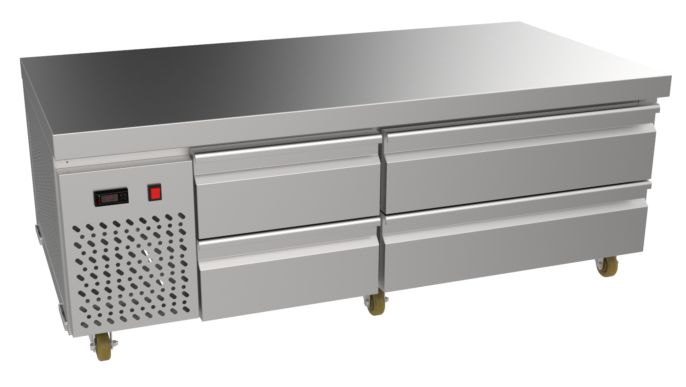


CHEF BASE DRAWER FREEZER
CF4S-4B-21
A robust freezing system featuring stainless steel construction, guaranteeing durability and reliability while delivering efficient cold storage of premium quality.
KEY FEATURES
Dependable freezing system with high power, rapid cooling capability, efficient internal air circulation, and consistent temperature maintenance for the preservation of food.
Temperature controls and display digitally integrated with an automatic defrost system.
A robust, self-contained system featuring stainless steel exteriors and interiors, a coated evaporator coil, and an oversized compressor mounted on the side.
Address: 7 El Esraa Street Off Lebanon Street, Mohandeseen, Giza, Egypt
Tel: (+20)1000028820
Fax: (+202)33039336
All major components are of EU origin and CE Certified. In line with policy to continually develop and improve its products, UNIVEST reserves the right to change dimensions, specifications, and design at any time without prior notice.
www.univest.com.eg

Slide 2
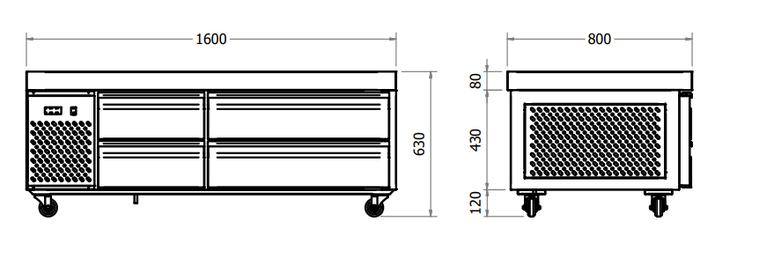
CHEF BASE DRAWER FREEZER
PRODUCT VIEWS & DIMENSIONS
TECHNICAL SPECIFICATIONS
Model | CF2S-08-21 | CF4S-12-21 | CF4S-16-21 | CF4S-20-21
Dimensions (W x D x H) | 80 x 80 x 63 cm | 120 x 80 x 63 cm | 160 x 80 x 63 cm | 200 x 80 x 63 cm
Number of Drawers | 2 | 4 | 4 | 4
Tray Capacity/Drawer | 1 GN 2/1 2 GN 1/1 | 2 GN 2/1 4 GN 1/1 | 3 GN 2/1 6 GN 1/1 | 4 GN 2/1 8 GN 1/1
Refrigerant | R 404 | R 404 | R 404 | R 404
Compressor Power | 1/2 hp | 1/2 hp | 1/2 hp | 1/2 hp
Voltage | 220 V/1 Ph | 220 V/1 Ph | 220 V/1 Ph | 220 V/1 Ph
Frequency | 50 Hz | 50 Hz | 50 Hz | 50 Hz
ADDITIONAL FEATURES
Heavy duty castors with breaks
Accommodates standard gastronomic trays GN 1/1 & GN 2/1
High efficiency polyurethane foam insulation
Self-closing drawers mechanism
Silicon rubber gasket for tight sealing
INSTALLATION
Installations must be in accordance with all local electrical systems, particularly the minimum wire gauge needed for field connection and ventilation supply.
Address: 7 El Esraa Street Off Lebanon Street, Mohandeseen, Giza, Egypt
Tel: (+20)1000028820
Fax: (+202)33039336
All major components are of EU origin and CE Certified. In line with policy to continually develop and improve its products, UNIVEST reserves the right to change dimensions, specifications, and design at any time without prior notice.
www.univest.com.eg

