Slide 1

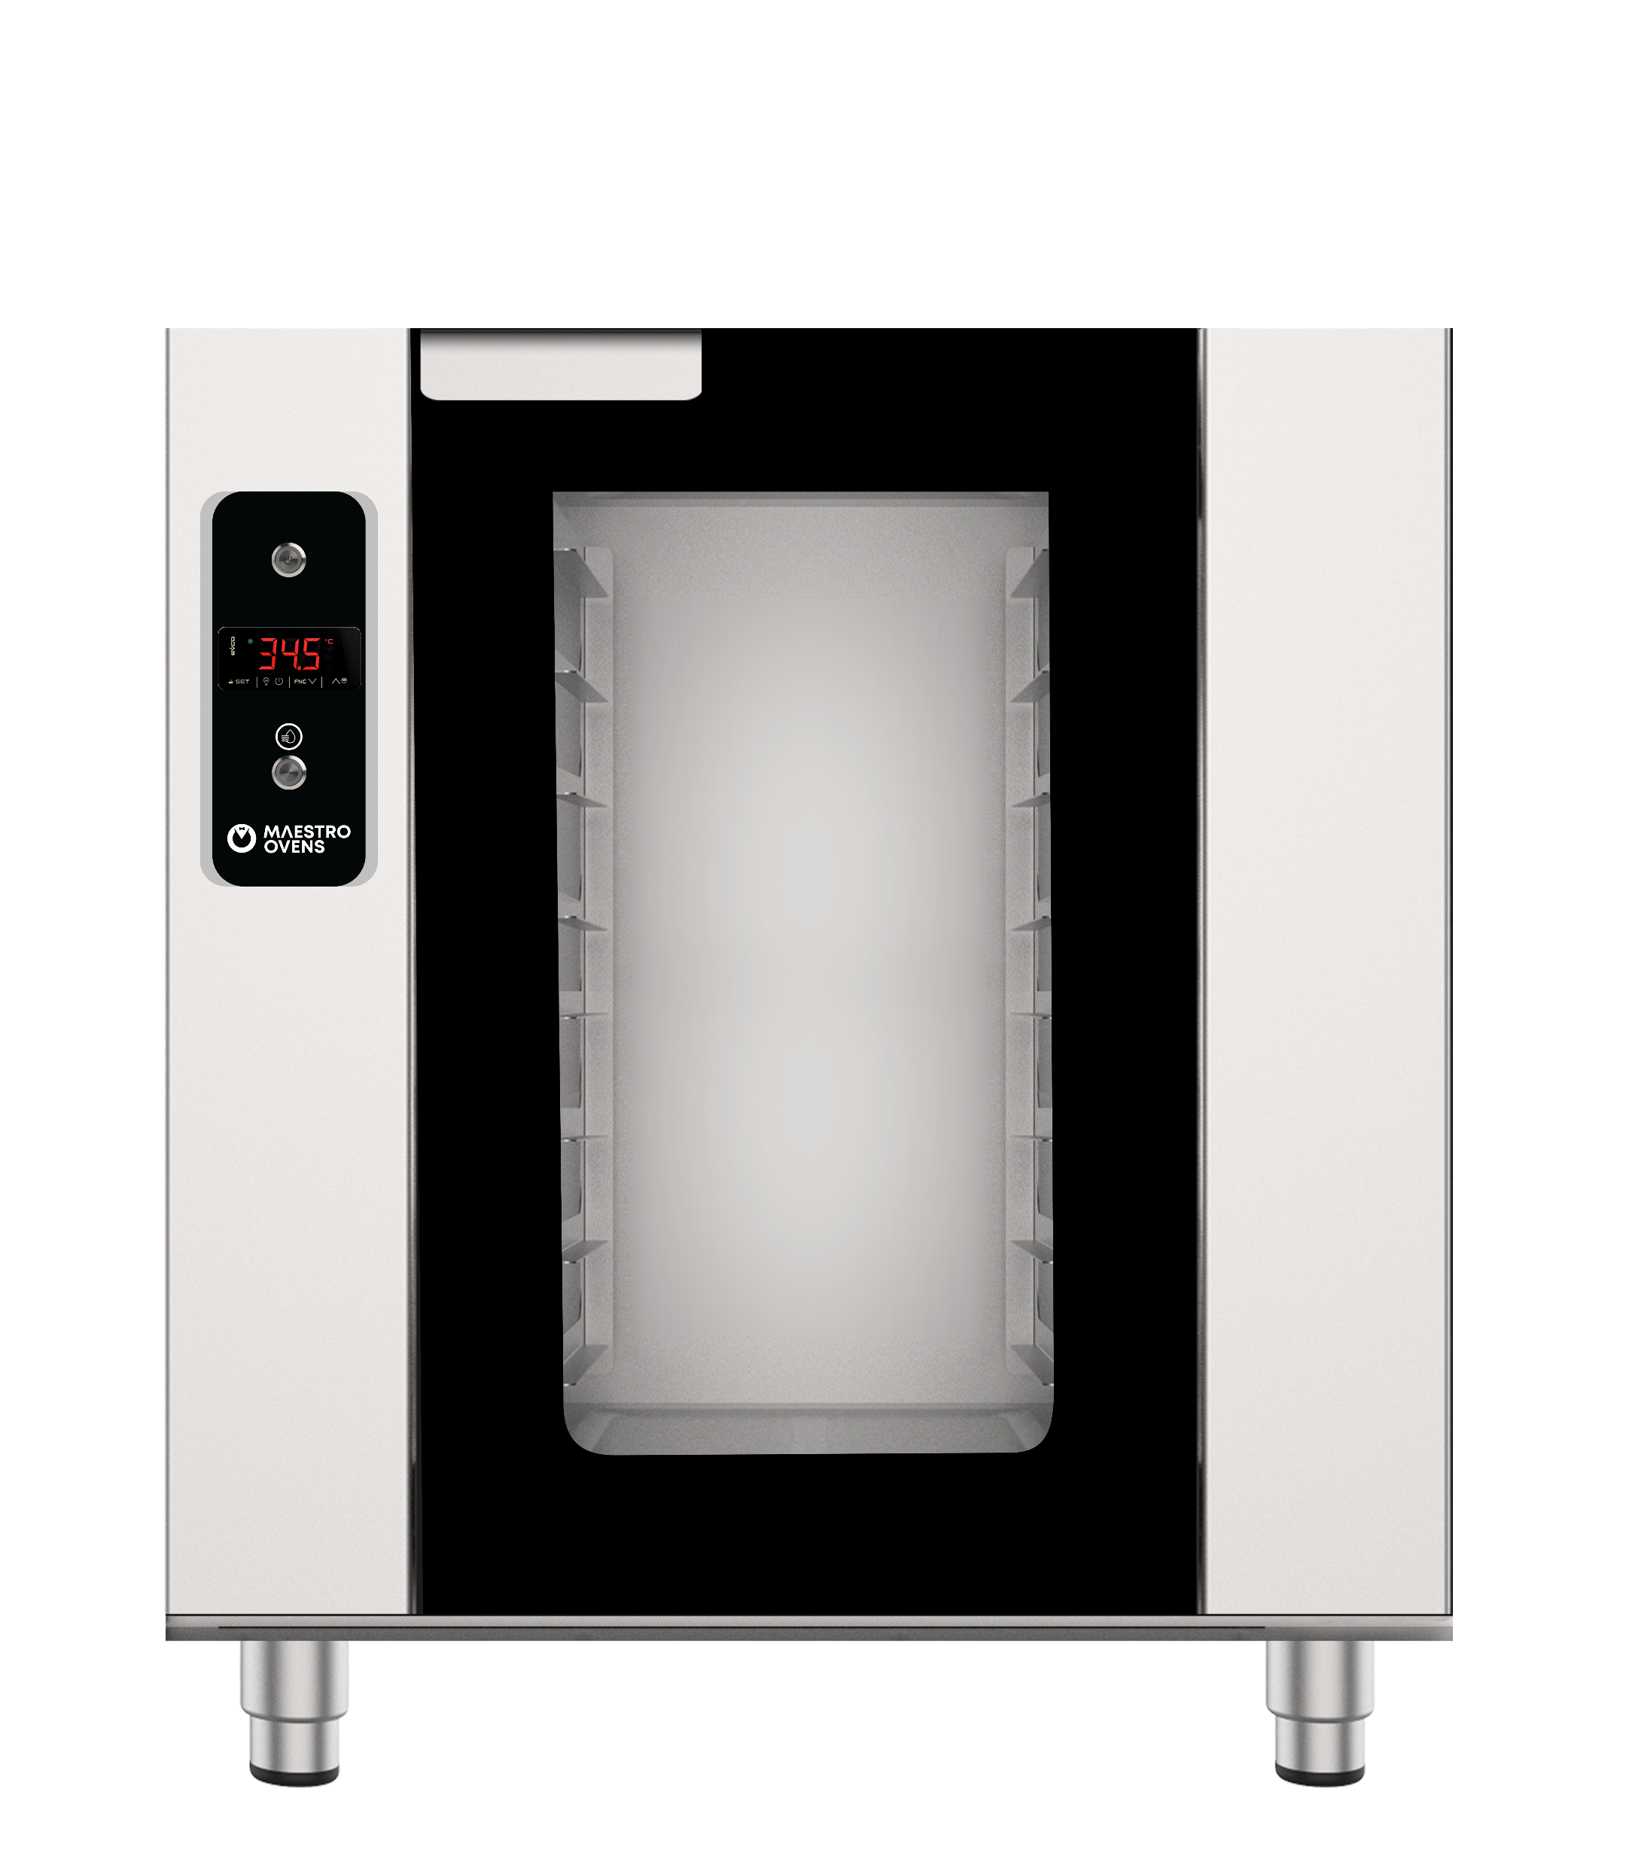


Project:____________ Item #:____________ Quantity:_____________
Electric Digital Heated Cabinet with Push Steam Button
DESCRIPTION
Crafted from durable stainless steel 304, this proofer features digital thermal control for precise temperature settings and a push steam button for instant steam, ensuring perfectly proofed dough every time.
KEY FEATURES
Optional Features
Durable, hygienic, and rust-resistant.
Precise temperature settings for optimal warming condition.
Ideal for batch cooking, catering and assembly line concepts.
Easy operation and maintenance for busy environments.
Ensures uniform texture and moisture in every batch.
Caster Wheels
Stainless Steel Doors
INSTALLATION
Installations must be in accordance with all local electrical systems, particularly the minimum wire gauge needed for field connection and ventilation supply.
TECHNICAL SPECIFICATIONS
Model | Capacity | Pitch mm | Energy Source | Voltage | Power Output | Type of Control | Dimensions (W x D x H) mm
EHC-0623-MMC | 5 Trays GN 1/1 | 75 | Electric | 220 - 240V 1Ph/50Hz | 2 kW | Digital | 520 x 750 x 650
Address: 7 El Esraa Street Off Lebanon Street, Mohandeseen, Giza, Egypt
Tel: (+20)1000028820
Fax: (+202)33039336
All major components are of EU origin and CE Certified. In line with policy to continually develop and improve its products, UNIVEST reserves the right to change dimensions, specifications, and design at any time without prior notice.
www.univest.com.eg

